Slide 1
Interkulturel Erhvervskommunikation ikek 7 Markedskommunikation Teorier og modeller epi-KU 2018
People buy things not only for what they can do, but also for what they mean. Sidney Levy (1959)
Modtagelse er fortolkning

Slide 2
Opsamling
Klassiske modeller
De 3 designaspekter
IMK-modellen
Kommunikations-planlægning
Promotion-mix
TMK-modellen
Gruppeopgave

Slide 3
Gruppeopgave (OBS ny opsætning)
Eksamensvirksomhed (organisation, institution m.m.)
SMP-analyse:
Hvilke segmenteringskriterier er de væsentligste?
Hvordan er jeres virksomheds målgruppe sammensat?
Forventes det, at denne sammensætning vil ændres pga. forskydning i livsfaser eller politiske forbrugere?
Hvordan positionerer virksomheden sig på hjemmemarkedet og på eksportmarkedet?
Hvilken betydning har SMP-analysen for virksomhedens promotion-mix?
Argumentér for den digitale indfødtes styrker og svagheder på arbejdsmarkedet
Opsamling
Klassiske modeller
De 3 designaspekter
IMK-modellen
Kommunikations-planlægning
Promotion-mix
TMK-modellen
Gruppeopgave

Slide 4
Hvilke mangler har de klassiske markedskommunikations-modeller (Lasswells samt Shannon og Weaver)?
Tager udgangspunkt i transmissionsparadigmet
Afsender- og effektorienterede
Ringe fokus på den kulturelle kontekst
Ringe fokus på sproglige og visuelle aspekter
Feedback begrænses til køb/ikke køb.
Weavers tilføjer begrebet ‘støj’
Opsamling
Klassiske modeller
De 3 designaspekter
IMK-modellen
Kommunikations-planlægning
Promotion-mix
TMK-modellen
Gruppeopgave

Slide 5
Kommentér følgende udsagn: Modtagelse er fortolkning
Sammenlign Frandsens analyse af de 4 P’er med de tre designaspekter
Fra modul 3:
Det funktionelle aspekt: Tekniske, praktiske krav, såvel set fra brugerens som fra producentens side; ergonomi, sikkerhed, dimensioner, produktion, lagring, transport m.m. Hvordan det virker.
Det æstetiske aspekt: Udseende. Hvordan det ser ud.
Det symbolske aspekt (signalværdien): Betydningen. Hvilken historie det fortæller.
Opsamling
Klassiske modeller
De 3 designaspekter
IMK-modellen
Kommunikations-planlægning
Promotion-mix
TMK-modellen
Gruppeopgave
Notes:
A sign (or representamen)^{[125]} represents, in the broadest possible sense of "represents". It is something interpretable as saying something about something. It is not necessarily symbolic, linguistic, or artificial. As Peirce sometimes put it (he defined sign at least 76 times^{[123]}), the sign stands for the object to the interpretant.
An object (or semiotic object) is a subject matter of a sign and an interpretant. It can be anything thinkable, a quality, an occurrence, a rule, etc., even fictional, such as Prince Hamlet.^{[126]} All of those are special or partial objects. The object most accurately is the universe of discourse to which the partial or special object belongs.^{[126]} For instance, a perturbation of Pluto's orbit is a sign about Pluto but ultimately not only about Pluto. An object either (i) is immediate to a sign and is the object as represented in the sign or (ii) is a dynamic object, the object as it really is, on which the immediate object is founded "as on bedrock".^{[127]}
An interpretant (or interpretant sign) is a sign's meaning or ramification as formed into a kind of idea or effect, an interpretation, human or otherwise. An interpretant is a sign (a) of the object and (b) of the interpretant's "predecessor" (the interpreted sign) as a sign of the same object. An interpretant either (i) is immediate to a sign and is a kind of quality or possibility such as a word's usual meaning, or (ii) is a dynamic interpretant, such as a state of agitation, or (iii) is a final or normal interpretant, a sum of the lessons which a sufficiently considered sign would have as effects on practice, and with which an actual interpretant may at most coincide.

Slide 6
Hvad karakteriserer IMK-modellen?
Tager udgangspunkt i interaktionsparadigmet
Fokus på budskabets fortolkning
Fokus på den kulturelle kontekst
Inkluderer genre (fortællende, instruerende, argumenterende, informerende, dramatiske m.m.) og koder (se også Dahl (modul 3) samt Mollerup (modul 4), Clotaire Rapaille (modul 6)
Hvilke tilføjelser til ovennævnte aspekter kan fremme viral kommunikation?
Mere fokus på de 4 C’ere
Løbende tilføjelse af nye, relevante kanaler til promotion-mixet (og evt. udrensning af gamle)
Aktiv monitorering af virksomhedes image (bl.a. på de sociale medier)
Opsamling
Klassiske modeller
De 3 designaspekter
IMK-modellen
Kommunikations-planlægning
Promotion-mix
TMK-modellen
Gruppeopgave
Notes:
A sign (or representamen)^{[125]} represents, in the broadest possible sense of "represents". It is something interpretable as saying something about something. It is not necessarily symbolic, linguistic, or artificial. As Peirce sometimes put it (he defined sign at least 76 times^{[123]}), the sign stands for the object to the interpretant.
An object (or semiotic object) is a subject matter of a sign and an interpretant. It can be anything thinkable, a quality, an occurrence, a rule, etc., even fictional, such as Prince Hamlet.^{[126]} All of those are special or partial objects. The object most accurately is the universe of discourse to which the partial or special object belongs.^{[126]} For instance, a perturbation of Pluto's orbit is a sign about Pluto but ultimately not only about Pluto. An object either (i) is immediate to a sign and is the object as represented in the sign or (ii) is a dynamic object, the object as it really is, on which the immediate object is founded "as on bedrock".^{[127]}
An interpretant (or interpretant sign) is a sign's meaning or ramification as formed into a kind of idea or effect, an interpretation, human or otherwise. An interpretant is a sign (a) of the object and (b) of the interpretant's "predecessor" (the interpreted sign) as a sign of the same object. An interpretant either (i) is immediate to a sign and is a kind of quality or possibility such as a word's usual meaning, or (ii) is a dynamic interpretant, such as a state of agitation, or (iii) is a final or normal interpretant, a sum of the lessons which a sufficiently considered sign would have as effects on practice, and with which an actual interpretant may at most coincide.

Slide 7
Gruppeopgave
Kommunikationsplanlægning
Skitsér gruppens eksamensprojekt ved brug af fig. 21.3 på side 133, dog uden ‘3.5 Måling af kommunikationseffekt’ og 3.6 ‘Udarbejdelse af budget’.
Opsamling
Klassiske modeller
De 3 designaspekter
IMK-modellen
Kommunikations-planlægning
Promotion-mix
TMK-modellen
Gruppeopgave
Notes:
A sign (or representamen)^{[125]} represents, in the broadest possible sense of "represents". It is something interpretable as saying something about something. It is not necessarily symbolic, linguistic, or artificial. As Peirce sometimes put it (he defined sign at least 76 times^{[123]}), the sign stands for the object to the interpretant.
An object (or semiotic object) is a subject matter of a sign and an interpretant. It can be anything thinkable, a quality, an occurrence, a rule, etc., even fictional, such as Prince Hamlet.^{[126]} All of those are special or partial objects. The object most accurately is the universe of discourse to which the partial or special object belongs.^{[126]} For instance, a perturbation of Pluto's orbit is a sign about Pluto but ultimately not only about Pluto. An object either (i) is immediate to a sign and is the object as represented in the sign or (ii) is a dynamic object, the object as it really is, on which the immediate object is founded "as on bedrock".^{[127]}
An interpretant (or interpretant sign) is a sign's meaning or ramification as formed into a kind of idea or effect, an interpretation, human or otherwise. An interpretant is a sign (a) of the object and (b) of the interpretant's "predecessor" (the interpreted sign) as a sign of the same object. An interpretant either (i) is immediate to a sign and is a kind of quality or possibility such as a word's usual meaning, or (ii) is a dynamic interpretant, such as a state of agitation, or (iii) is a final or normal interpretant, a sum of the lessons which a sufficiently considered sign would have as effects on practice, and with which an actual interpretant may at most coincide.

Slide 8
Skitsér et udvidet promotionmiks:
Reklame (betalt)
Salgspromotion (tilbud, m.m.)
PR (’gratis’)
Events
Sponsorering
Personlig salg (interaktiv face-to-face)
Direkte salg (brev, mail, telefon)
Online marketing
Viral kommunikation
Blogs, vlogs
Product placement
Packaging
Flash mobs
m.m.
Opsamling
Klassiske modeller
De 3 designaspekter
IMK-modellen
Kommunikations-planlægning
Promotion-mix
TMK-modellen
Gruppeopgave

Slide 9
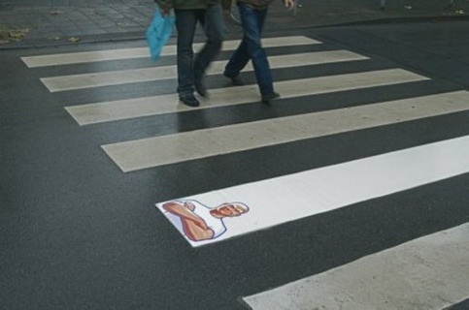

Slide 11
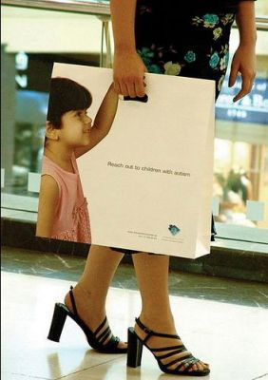
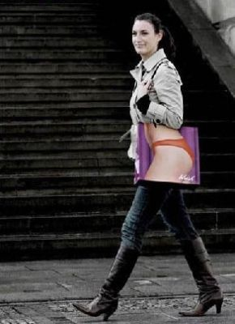

Slide 12
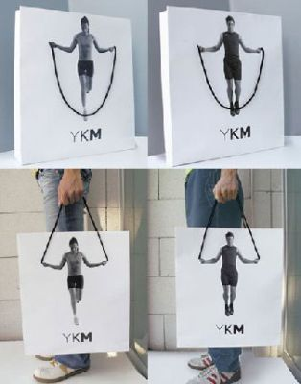
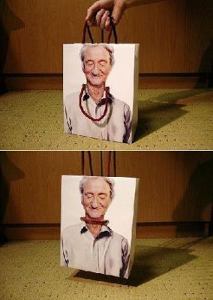

Slide 13
Vigtige faktorer ved sammensætning af et promotion-mixet
Produkt; produkttype
Markedsforhold; B2B/B2C
Push; man skubber produktet gennem forhandlerleddet eller
Pull; slutbrugeren trækker produktet gennem forhandlerleddet.
Hvor i købsprocessen er de forskellige målgrupper? Brug gerne AIDA-E modellen
PLC-kurven
Beskriv jeres virksomhed/produkt ved hjælp af ovenstående
Opsamling
Klassiske modeller
De 3 designaspekter
IMK-modellen
Kommunikations-planlægning
Promotion-mix
TMK-modellen
Gruppeopgave

Slide 14
Opsamling
Klassiske modeller
De 3 designaspekter
IMK-modellen
Kommunikations-planlægning
Promotion-mix
TMK-modellen
Gruppeopgave
Skitsér gruppens eksamensprojekt ved brug af enten fig. 21.3 på side 133, dog uden ‘3.5 Måling af kommunikationseffekt’ og 3.6 ‘Udarbejdelse af budget’ eller den koncentrerede TMK model

